Slide 1
Aspect orientated configuration of software product line features
Product derivation, quality and changeability

Slide 2
What we will analyze?
Implementation of variable features of given domain
Influence of using AspectJ on quality (code, product derivation)
Possibility to derive product not dependent on aspectJ – aspect programming language
What techniques should be applied and which consequence it will have
Is there a way to build generator which supports derivation of all possible products for next validation

Slide 3
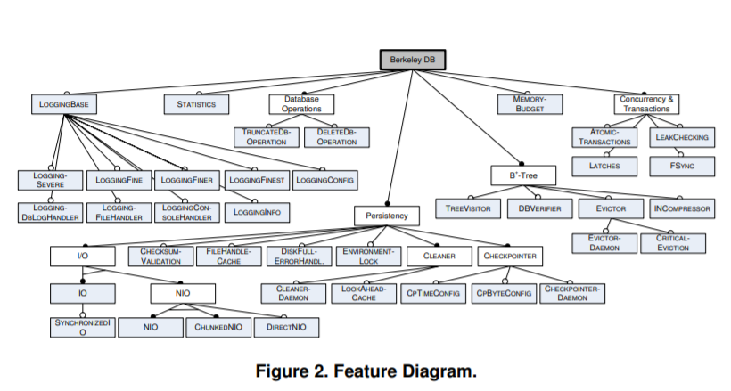
Domain analysis and modeling
Using feature diagrams
For some requirements can change in time
FEATURE MODELS
What is common and what differs
Mapping of variables can be done in different ways
For modelling solution space
Associates solution space elements with problem space features
Refactoring of existing system

Slide 4
Creation of features

Slide 5
Quality of applying voluntary features using AspectJ
More complex AspectJ solution in some case
2x as long
PROBLEMS
Redundant use of parameters in AspectJ pointcuts
Need of using state extension
Use hook methods to extend context
Scope problem
Priviledged aspect cant access non-public variables or inner ones
Inability to access local methods
Inability to create own exception for new Aspects
Use of dynamic exceptions is required

Slide 6
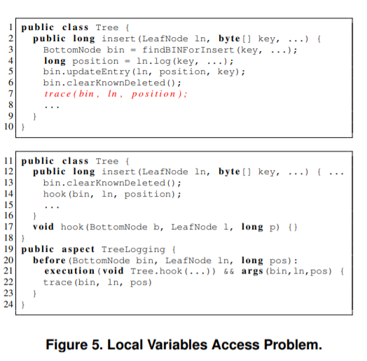
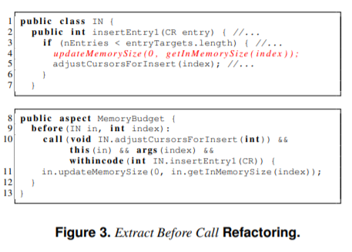

Slide 7
Software design according feature diagram
Given functionality can spread trough whole system – in not modular systems
This functionality can be voluntary – marked in feature diagram this way
For using aspects codes should be created according some principles
How to derive product with / without given feature if feature has many classes and its implementation can include aspects too
NEED TO KNOW CERTAIN DOMAIN

Slide 8
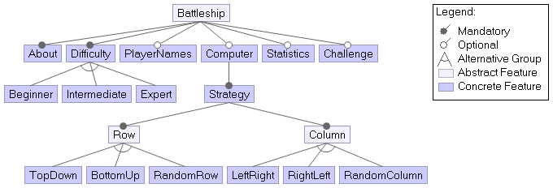
Given solution
Text interface
Console game – can play using command line
Feature analysis already created – domain already analyzed
Suitable for next implementation and improvements
Real application

Slide 9
Mandatory parts in the game
Prints info
at the beginnning
Implemented
Using
aspect
Only random number for rows and columns

Slide 10
Our focus - focus on variable features
Chosing one feature
From set can be
Implemented
in aspect oriented way
+ maybe other potential improvements from observed domain
clever
From the same
author in another
his scatch

Slide 11
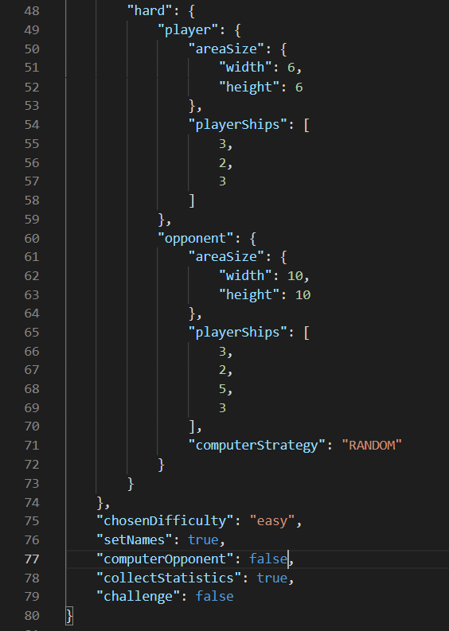
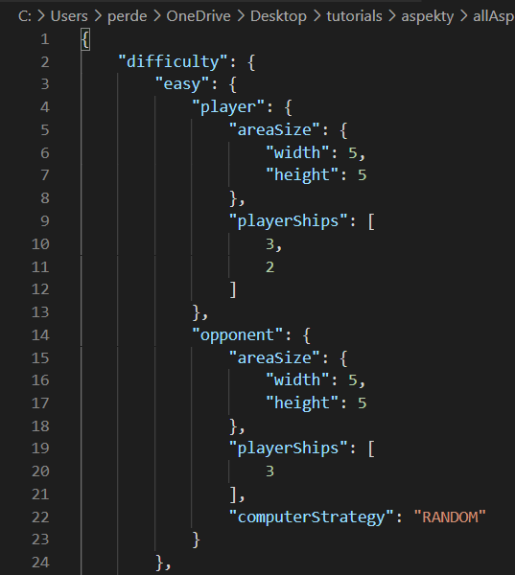
Configuration using JSON File

Slide 12
Config to feature model mapping

Slide 13
Adding support for defining names for users
public aspect PlayerName {
Adds new variable for name
private String Player.name;
private void Player.setName(String playerName) {
this.name = playerName;
}
private String Player.getName() {
return this.name;
}
Aspect can be excluded from execution
}
With possible al his children features

Slide 14
public aspect PlayerName {
Player around(): call(Player.new(..)) && if(Configuration.setNames){
Scanner reader = InputReader.getReader();
System.out.println("Set player name:");
String playerNameLine = reader.nextLine().replace("\n", "");
Player createdPlayer = proceed();
createdPlayer.setName(playerNameLine);
System.out.println(createdPlayer.getName());
return createdPlayer;
}
Gets players object
and sets name
}

Slide 15


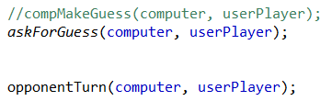
Adding support for computer or user opponent
Player as opponent
Computer as opponent
Changes to use both – aspect use
…
…
Like “hooks”

Slide 16

Mapping of pointcuts
…
…

Slide 17
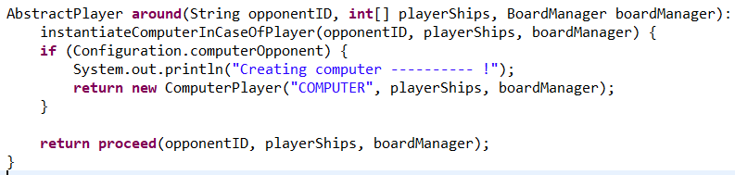
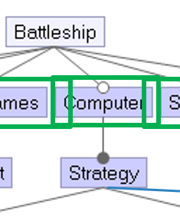
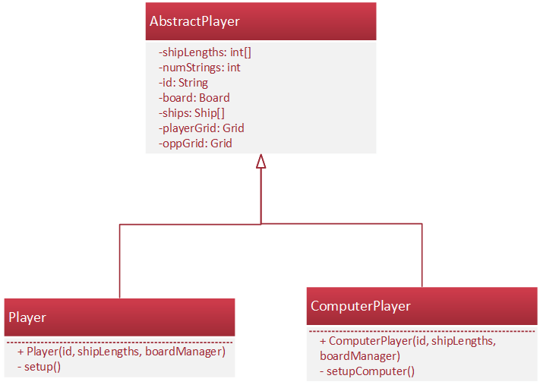
Pattern Cockoo’s egg
Created if
condition is
met
Created by default

Slide 18
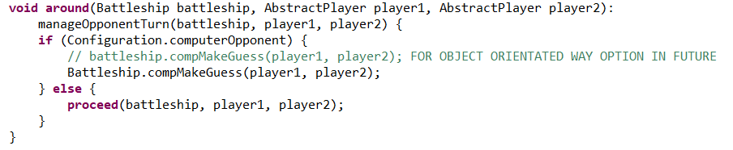

Variable encapsulation problem
In player instance chooser aspect:
The same problem
To call function to manage computer guess,
which should not be publicly visible

Slide 19

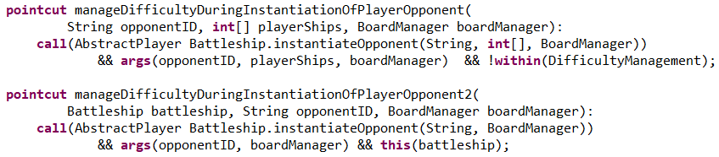

Difficulty configuration
Prepare configuration (with difficulty settings) before creating player’s specific instance
1. PREPARATION
2. POINTCUTS
The same pointcuts
(with other names)
“Hook“ functions

Slide 20
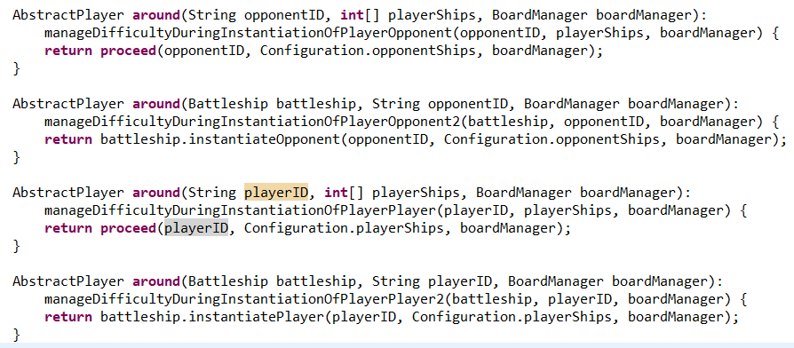
3. APPLYING CONFIGURATION VALUES
Calling the method with the same name but other arguments,
to apply other aspect managing player’s instance (showed previously)

Slide 21

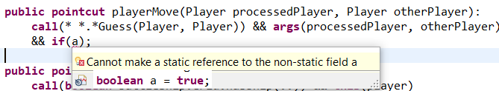

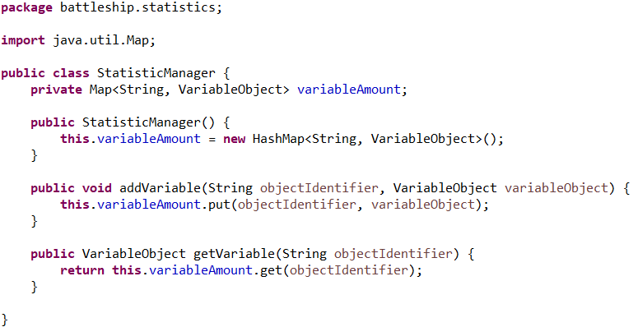
Statistics configuration
MOVES
HITS
Statistics observation are gathered
if value of variable from config file is True
MISS = MOVES - HITS
Statistics objects are stored in hash-map

Slide 22
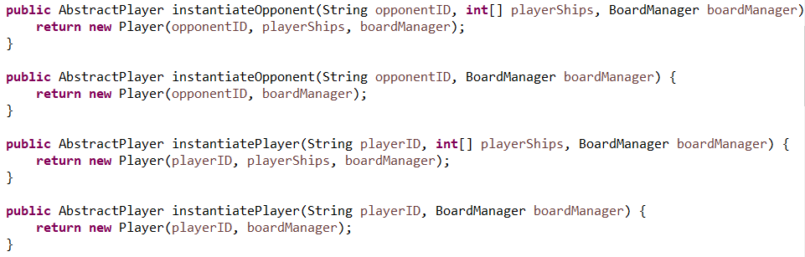

Slide 23
Problems of given solution
Created only mandatory features in a way that not provides:
product derivation
Voluntary features in configurable way
Hardcoded functionality – needs refactoring
Option to choose from options (in case of difficulty in game)
Only console environment – (we will not remake)
No code reuse – repetition on many places
Still not extensive game – (but real application for given domain)
Lack of encapsulation and object oriented features
Needs divide static method to appropriate classes
Needs manage access from parent object
Business concerns are not fully separated

Slide 24
Object oriented redesign
Hardcoded parts should be changed to support configurability
Different lengths of board
Support for adding player
Concerns should be separated
Setup of player should be part of player class
Setup of computer should be part of computer class
Static methods should be replaced by objects
Performing refactoring of project

Slide 25
Design with aspects as voluntary functionality
Aspect can be removed from execution – variable functionality
Aspect can intercepts points in execution and helps to derive product
Good to extend functionality in various ways
Add voluntary features
Choosing specific strategy from strategy options – from mandatory ones too
Enhance necessary functionality on existing classes (includes classes of additional features)

Slide 26
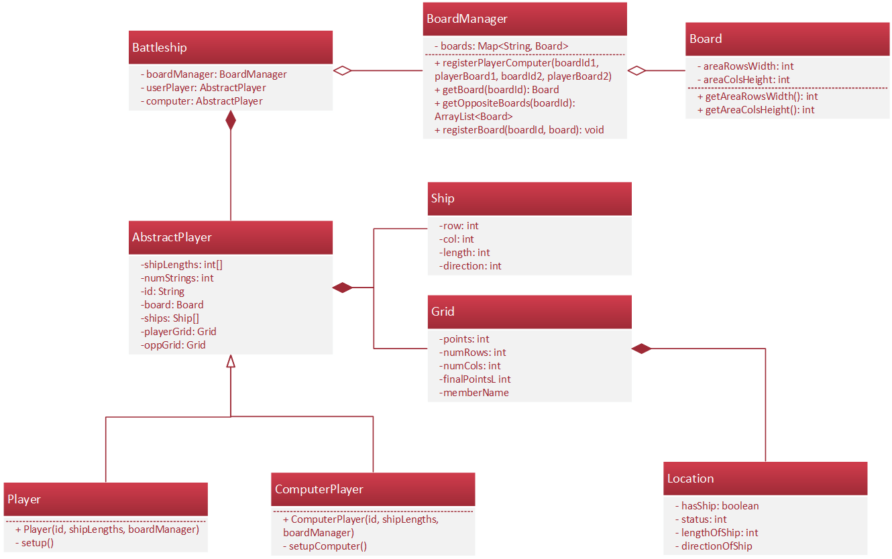
Schema after refactoring

Slide 27
Product derivation

Slide 28
Derivation rules
{“computer”: “true”}
{“difficulty”: “beginner”}
{“statistics”: “true”}
{“playerNames”: “true”}
{“challenge”: “true”}
{}
{“computer”: “true”,
“strategy”: “true”}

Slide 29
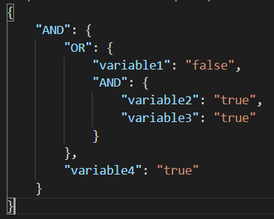
AND or OR JSON TREE
(variable1 OR (Variable2 AND variable3)) AND variable4
2. If given variable variable1 is false in config then
OR is true, otherwise remaining branches should be true
1. If given variables in config are both true, then
AND above is true
3. If given variable variable4 is true in config and
whole OR is true, then parent AND is true
4. If whole is true, then we can copy annotated method

Slide 30


Applied annotations types
//@{}
//#{}
//%{}
For whole
class/aspect/interface
For class/aspect
method only
For import
statement only
Copying of whole file with class
Copying of given method
Copying of given import
//@{}
//#{}
//%{}

Slide 31
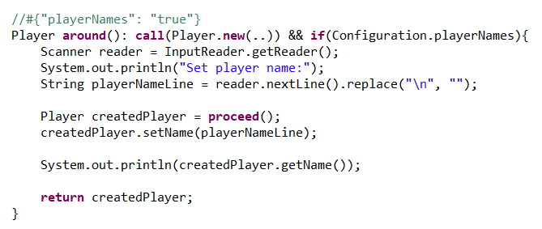
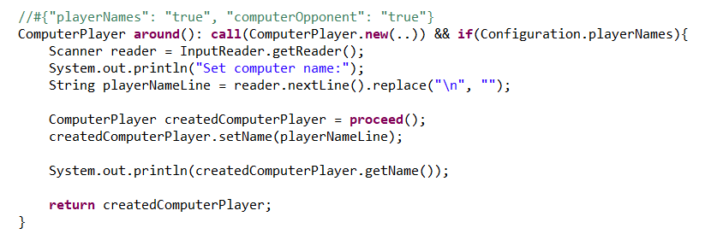
Variables features can interfere
Setting names for players needs update when computer player is added
Variable feature for
setting player names
We can’t use //@ annotation,
because of many different variable features
Method will be included only if all conditions are met (for specific feature)
Additional variable
feature for
managing also
computer name

Slide 32
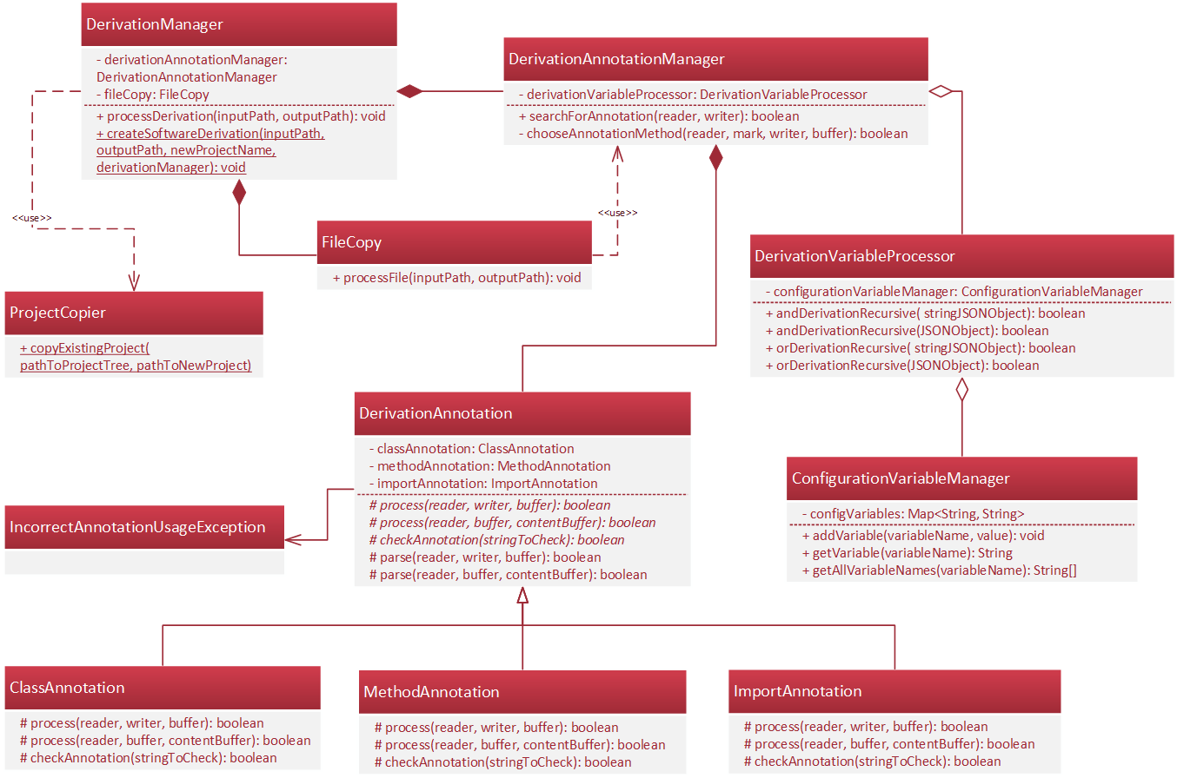

Slide 33
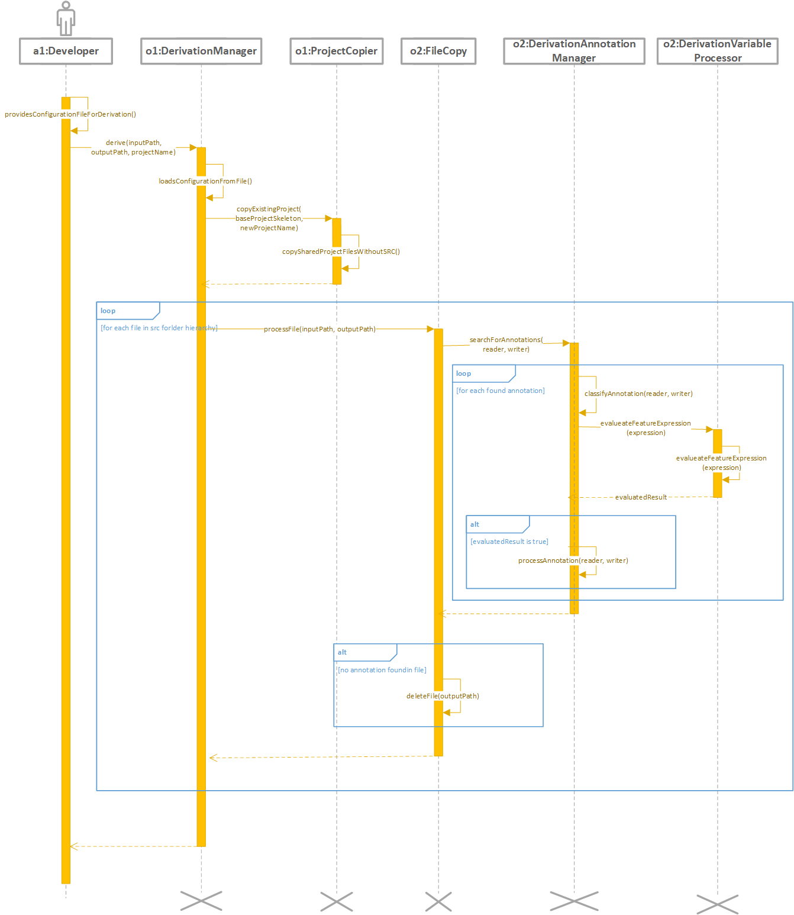

Slide 35
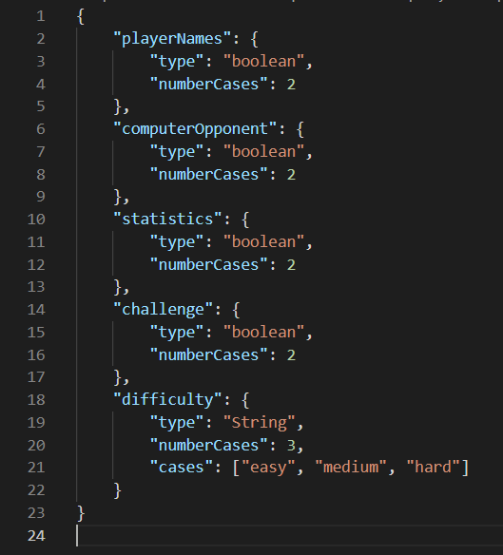
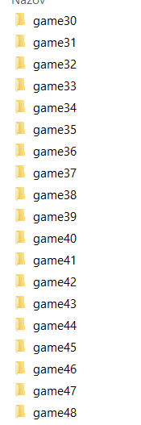
Generating all cases
variableRestrictions.json
2
2
48
2
2
3

Slide 36
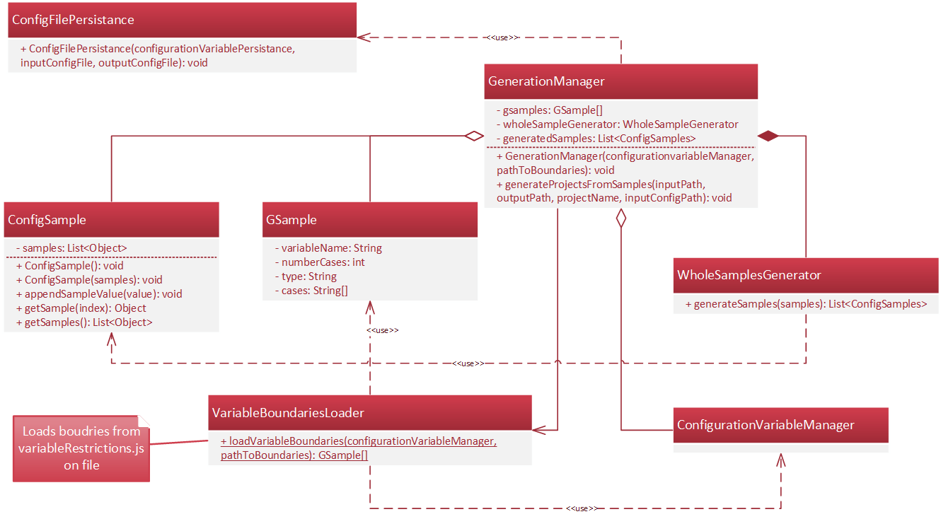

Slide 37
Application on fractals

Slide 38
Many possible derivations of fractals
Fractal domain
Fractal derivation
Aesthetic feeling
Product derivation
Product validation
EXTENSIVE SOLUTION SPACE

Slide 39
How to catch all feature variability?
A need for best product derivator
When domain is focused on our aesthetic perception
In there suitable feature diagram?
A need to generate all possible derivations.
Can they include only mathematical model?

Slide 40
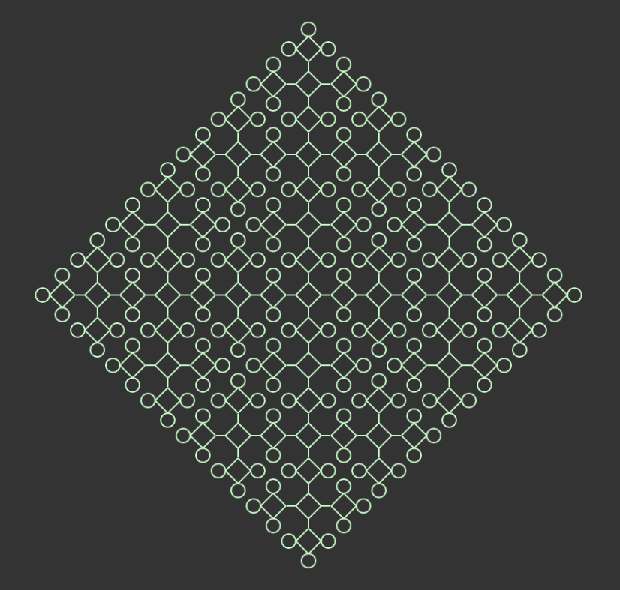


Given samples of one type

Slide 41
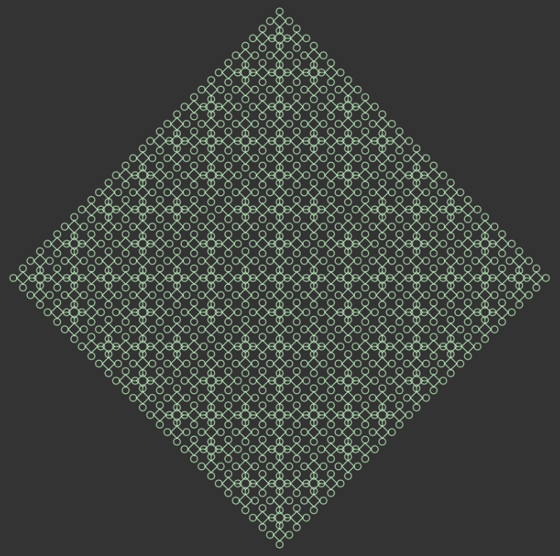



Slide 42

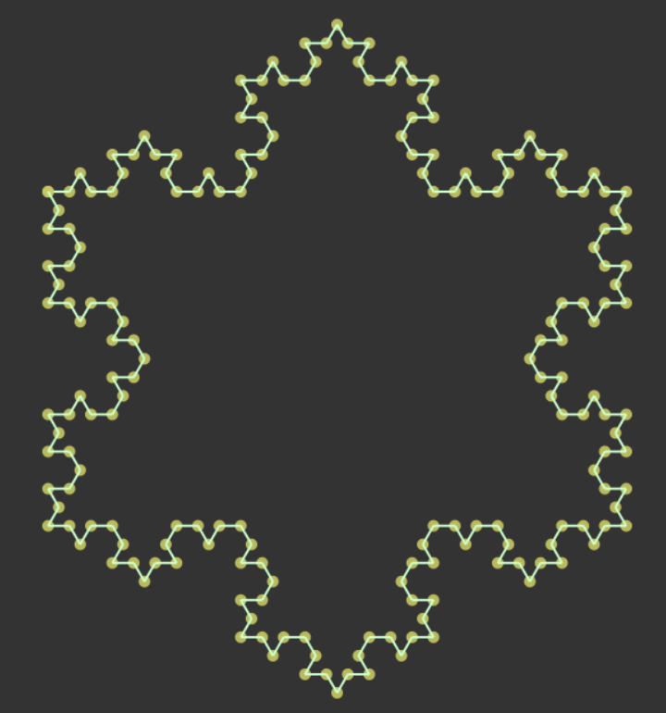

Many types
Different approaches how to generate

Slide 43
Bibliography
BEUCHE, Danilo a Mark DALGARNO, 2006. Software Product Line Engineering with Feature Models. 2006, s. 7.
BOTTERWECK, Goetz, Kwanwoo LEE a Steffen THIEL, 2009. Automating Product Derivation in Software Product Line Engineering. 2009, s. 6.
KASTNER, Christian, Sven APEL a Don BATORY, 2007. A Case Study Implementing Features Using AspectJ. V: 11th International Software Product Line Conference (SPLC 2007): 11th International Software Product Line Conference (SPLC 2007) [online]. Kyoto, Japan: IEEE, s. 223–232 [cit. 30.9.2021]. ISBN 978-0-7695-2888-5. Dostupné na: doi:10.1109/SPLINE.2007.12
LADDAD, Ramnivas, 2003. AspectJ in action: practical aspect-oriented programming. Greenwich, CT: Manning. ISBN 978-1-930110-93-9.
PELÁNEK, Radek, 2012. Programátorská cvičebnice. 1. vydání. Brno: Computer press. ISBN 978-80-251-3751-2.
VRANIC, Valentino a Roman TÁBORSKÝ, 2016. Features as transformations: A generative approach to software development. Computer Science and Information Systems [online]. 2016, roč. 13, č. 3, s. 759–778. ISSN 1820-0214, 2406-1018. Dostupné na: doi:10.2298/CSIS160128027V
YOUNG, Trevor J a B MATH, 1999. Using AspectJ to Build a Software Product Line for Mobile Devices. 1999, s. 73.

Slide 45
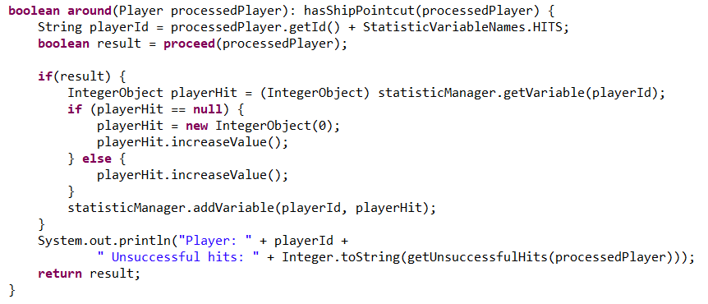
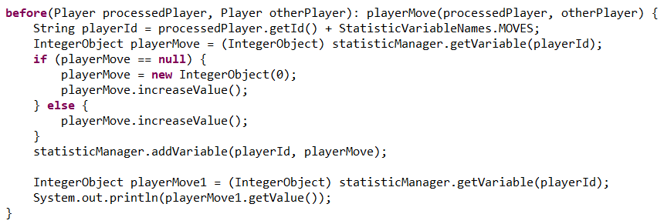

Slide 46
Quality of applying voluntary features using AspectJ
Riešenie využívajúce AspectJ je vo väčšine prípadov komplexnejšie
2x tak dlhé
PROBLÉMY
Potreba aplikovať rozšírenie stavu
Nadbytočné použitie parametrov v aspekt bodových prierezoch
Použitie závesných metód pre rozšírenie obsahu
Problém rozsahu platnosti
Privilegovaný aspekt nemôže pristúpiť k neverejným premenným
Nemožnosť pristúpiť k lokálnym metódam
Nemožnosť tvorby vlastných výnimiek pre nové aspekty
Je nutné použiť dynamické výnimky

Slide 47
{“computer”: “true”}
{“difficulty”: “beginner”}
{“statistics”: “true”}
{“playerNames”: “true”}
{“challenge”: “true”}
{}
{“computer”: “true”,
“strategy”: “true”}

Slide 48
variableRestrictions.json
2
2
48
2
2
3

